Slide 1
Data Preparation & Modeling
Use R to prepare data and build models

Slide 2
Data preparation
Fix data quality issues identified in code book
Convert categorical features to Numeric
Mapping: like for Device 1-Mobile, 2-Desktop
Dummy variables: using dummies package, then sum(n-1) of dummy variables
Split data for each user group: Control (Old video) & Test (New video) to build separate classification models
Split data into training/testing set
Use caTools sample.split function to divide data into 80:20.
80% training set, 20% testing set

Slide 3
Select Model
First check data for model assumptions:
Input variables are NOT related (corr = 0) False
Input variables are normally distributed (Skewness=0/Histogram) False
All Input variables must be numeric (Map/Dummy) True
No missing values (complete.cases) True
TV is binary 0/1 True
Data is linearly separable (Scatter plot) False
So Decision Tree, K Nearest Neighbor, Logistic Regression, K-SVM

Slide 4
Modeling
Split data (Training/Test)
Scale data (Only Numerical Algo: K Nearest Neighbor, Logistic Regression & Kernel-Support Vector Machine)
Fit Model
Test Model (predict)
Assess and Evaluate Model
Accuracy, F1 Score (Precision, Recall) & Processing Time
Calculate Conversion rate = mean(ftrial)
Visualize Results (Decision Tree etc)

Slide 5
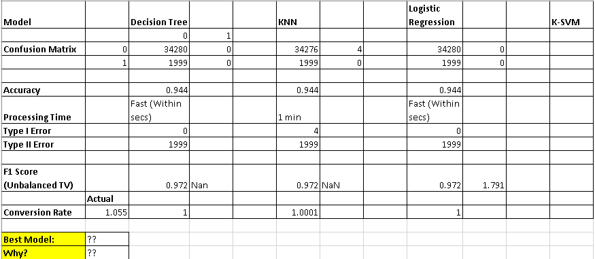
Model Comparison (Choose Best Model)

